Slide 1

Integration of Heterogeneous Wireless Access Technologies
A challenging research opportunity

Slide 2
Presentation Outline
Introduction to Heterogeneous Wireless Research
Research at Berkeley ( Video presentation )
Research at Cambridge
Finally, Discuss a paper published on July 2004 by Cambridge Group entitled
“ Client Based Handoff Mechanism for Mobile IPv6 Wireless Networks”
Authors – Leo with Univ. of Cambridge
Glenford with AT & T Laboratories

Slide 3
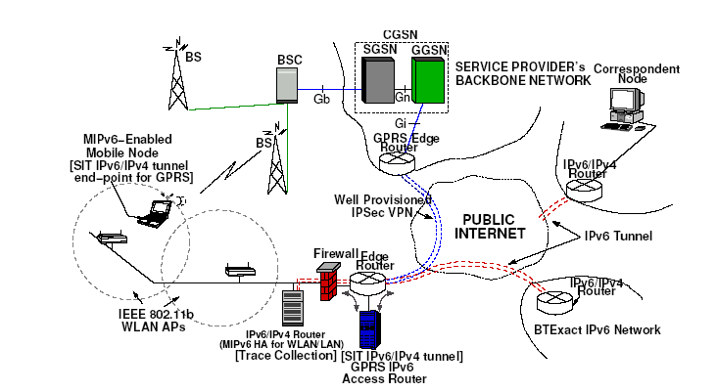
Introduction
Take a look at a heterogeneous wireless environment …..
The integration of heterogeneous wireless networks is one of the
most important research area in the wireless field

Slide 4
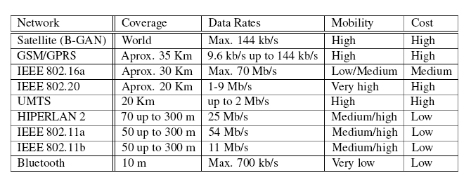
Constituents of the Heterogeneous Environment
Table -Diversity in existing and emerging wireless access
technologies

Slide 5
Research challenges in Heterogeneous Wireless Networks
Provide ubiquitous Internet access to the Mobile Node
Shield the Mobile Node from Network Heterogeneity
Maintain the same level of Service
Improvements to the Mobile IPv6 protocol
Pricing Models for such heterogeneous networks

Slide 6
Research at Berkeley
Project title- BARWAN ( Bay Area Research Wireless Access Network)
Heterogeneous Test bed- San Francisco Bay Area (Satellite, GPRS, WLAN, Infra Red)
Goal- To demonstrate a scalable architecture that can support
ubiquitous wireless access across multiple overlaid networks.
Highlights -
1) Uses a proxy server to truncate data depending on the mobile device.
2) Policy Based Handoff over Heterogeneous Wireless Access Networks.( J. Helen was the first to propose this handoff)

Slide 7

Bay Area Research WAN ( BARWAN)

Slide 8
Research at Cambridge
Project Name- Cambridge Open Mobile Systems ( COMS )
Laboratory- Communication Engineering
Goal – Supporting Seamless Mobility in Mobile IPv6 Networks
Test bed – Mobile IPv6 based GPRS/3G- WLAN- LAN
and a Blue tooth Personal Area Network.

Slide 9
Research at Cambridge (COMS)..contd
Highlights of the COMS project
Client Based Algorithm for fast horizontal handovers
GPRS/WLAN/LAN loosely coupled MIPv6 based test bed
Analysis of MIPv6 performance during vertical handovers
Methods to minimize vertical handover latency
Analysis of UDP/TCP performance for vertical handoffs

Slide 10
Research Paper (Cambridge)
Title -Client Based Handoff Mechanism for Mobile IPv6
Networks
Problem Statement-
The current proposed protocol MIPv6 specification does not
support a suitable vertical handoff mechanism.
Solution-
A efficient handoff Mechanism is proposed and tested real time
on a heterogeneous test bed

Slide 11
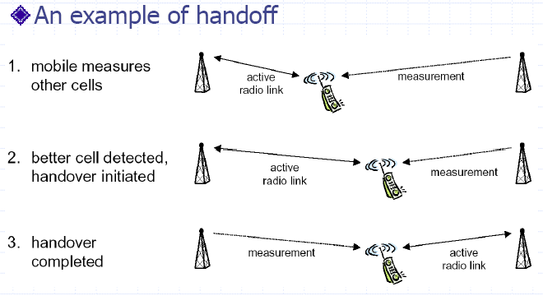
Let us refresh Some Basics of Handoff-
Handoff is defined as a process used to allow a call/data
transfer to continue as the mobile terminal moves btw cells

Slide 12
Some Basics..contd
Hard handoff vs. Soft handoff
Hard handoff- break before make
Soft handoff – Make before break
Vertical Handoff vs. Horizontal Handoff
Vertical Handoff- Between Different Networks
Horizontal Handoff- Between Same Networks
Decision to handoff is based on the received
signal strength or S/I ratio.

Slide 13
Two types of handoff mechanisms were investigated at Cambridge
Network controlled handover-
Mobile Node reports the received signal strengths from various
base stations to the network
Network then controls the handover
Network-controlled handover is unsuitable for vertical handovers,
since each network will have to be aware of the characteristics of all
the other wireless networks to be able to take the decision.
Client controlled handover-
Mobile Node controls the handover
The mobile node can take into account various factors such as
    the state of transport connections,
    the applications running on the mobile,
    the traffic conditions in all available overlapped cells

Slide 14
Tasks implemented by Client Handover Mechanism
control and force handovers,
determine the best link,
handover at the appropriate time,
and resume active TCP connections.
Client Handover Sequence of operation
Receives IPv6 router advertisements( RA) from nearby access points
Advertisements are stored in Mobile Host RA cache
Advertisement information include signal strength, link-layer metrics
along with time stamp.
RA cache is examined to determine the next access point to which
the mobile node should be attached
TCP connections are forced to resume swiftly avoiding TCP slow
start and packet loss.

Slide 15
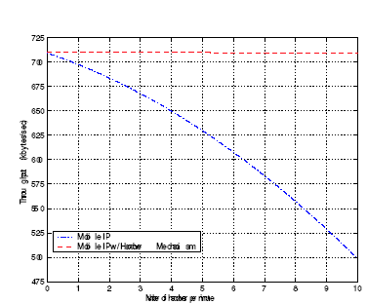
Simulation results at COMS test bed
Throughput of a UDP data stream versus the handover frequency
Blue line- Mobile IP
Redline- Mobile IP with client based handover

Slide 16
What lead to such a performance…??????
Fast Router Advertisement:
Reduces network detection time
However Router advertisement frequency can be reduced with
larger network size
Router Advertisement(RA) caching:
Helps us proactively decide next attachment point
The detection time for RA lookup during handover execution
is eliminated, improving overall performance
Binding Update bi-casting:Reduces registration time R_t
For a given network -
Round Trip Time (RTT) = Minimum Latency
Bi-cast Binding updates – Allows registration earlier through a
smaller network having lower RTT.

Slide 17
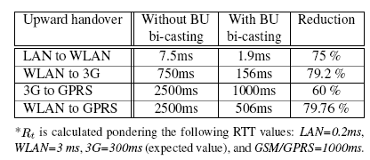
Table – This shows how Binding Update Bi-casting reduces
registration time

Slide 18
Summarizing……..
Introduced Heterogeneous wireless research particularly
at Berkeley and Cambridge research laboratories
Introduced a better handover approach called as client based
handover mechanism for Mobile IPv6
The improvements in the proposed approach were –
  Faster Router Advertisements
  Router Advertisement Caching
  Bi- cast Binding updates
  And Thank you everyone for your attention !

